Slide 1
SPARK - BASICS & DEEPDIVE
Amarnath Kallam

Slide 2
What Is Spark ?
Spark is a platform that allows for large-scale, cluster-based, in-memory data processing.
It enables fast, large-scale data engineering and analytics for iterative and performance-sensitive applications.
It offers development APIs for Scala, Java, Python, and R. In addition, Spark has been extended to support SQL-like operations, streaming, and machine learning as well.

Slide 3
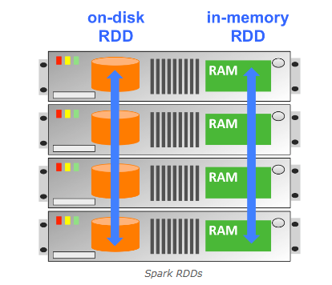
What Is An RDD ?
To leverage Hadoop’s horizontal scalability, Spark processes data in a Resilient Distributed Dataset, called an RDD.
An RDD is a fault-tolerant collection of data elements. An RDD is created by starting with a file on disk, or a collection of data in memory in a driver program. Each RDD is distributed across multiple nodes in a cluster. This enables parallel processing across the nodes.
Allowing RDDs to reside and be processed in memory dramatically increases performance especially when a dataset needs to be manipulated through multiple stages of processing. The data in an RDD can be transformed and analyzed very rapidly.

Slide 4
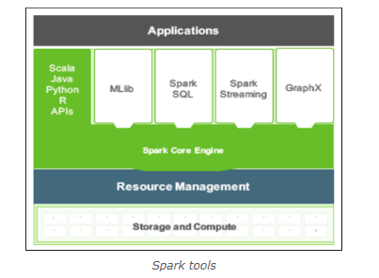
Spark In Real Time
Coming from the Spark project, Spark Core supports a set of four high-level tools that support SQL-like queries, streaming data applications, a machine learning library (Mlib), and graph algorithms (GraphX).
In addition, Spark also integrates with a number of other HDP tools, such as Hive for SQL-like operations and Zeppelin for graphing / data visualization.

Slide 5
Spark REPL Shells
REPL stands for “Read, Evaluate, Print, Loop.” REPLs take a single user input, evaluates it, and returns the result.
There are two REPLs available in Spark – one for Python and one for Scala. These are also sometimes referred to as “Spark shell” applications.
In order to start the Python shell, the user needs to enter "pyspark" on the command line. In order to start the Scala shell, the user needs to enter "spark-shell" on the command line

Slide 6
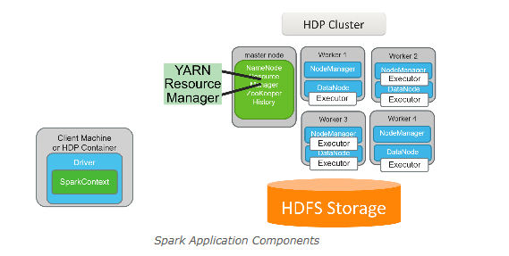
Enterprise Spark Application Components
There are five core components of an enterprise Spark application in HDP. They are the Driver, SparkContext, YARN ResourceManager, HDFS Storage, and Executors.
When using a REPL, the driver and SparkContext will run on a client machine. When deploying an application as a cluster application, the driver and SparkContext can also run in a YARN container. In both cases, Spark executors run in YARN containers on the cluster.

Slide 7
Spark Driver
The Spark driver contains the main() Spark program that manages the overall execution of a Spark application. It is a JVM that creates the SparkContext which then communicates directly with Spark. It is also responsible for writing/displaying and storing the logs that the SparkContext gathers from executors.
The Spark shell REPLs are examples of Spark driver programs.
IMPORTANT: The Spark driver is a single point of failure for a YARN client application. If the driver fails, the application will fail. This is mitigated when deploying applications using YARN cluster.

Slide 8
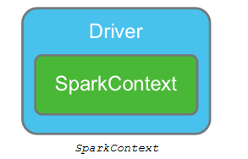
Why is SparkContext a VVIP ?
For any application to become a Spark application, an instance of the SparkContext class must be instantiated.
The SparkContext contains all the code and objects required to process the data in the cluster, and works with the YARN ResourceManager to get the requested resources for the application.
It is also responsible for scheduling tasks for Spark executors. The SparkContext checks in with the executors to report work being done and provide log updates.
A SparkContext is automatically created and named sc when a REPL is launched.
The following code is executed at start up for pyspark:
from pyspark import SparkContext, SparkConf conf = SparkConf() conf = SparkConf() sc = SparkContext(conf=conf)

Slide 9
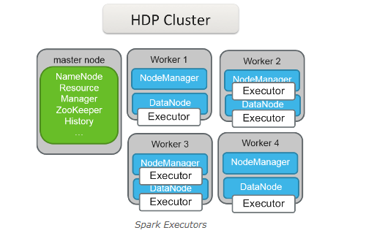
Spark Executors
The Spark executor is the component that does performs the map and reduce tasks of a Spark application, and is sometimes referred to as a Spark “worker.” Once created, executors exist for the life of the application.
Spark executors function as interchangeable work spaces for Spark application processing. If an executor is lost while an application is running, all tasks assigned to it will be reassigned to another executor. In addition, any data lost will be recomputed on another executor.
Executor behaviour can be controlled programmatically. Configuring the number of executors and their resources available can greatly increase performance of an application when done correctly.

Slide 10
Resilient Distributed Datasets (RDDs)
The Resilient Distributed Dataset (RDD) is an immutable, distributed, and resilient collection of elements that can be operated on in parallel.
An RDD is composed of one or more partitions that can be distributed across nodes in the cluster. These partitions are immutable, meaning when changes occur, new RDDs are created rather than having those changes written to existing RDDs.
They are also resilient, meaning if an RDD partition fails, it can be recreated on another node.
For HDFS files, the RDD partitions will be aligned with the file’s blocks to maximize parallelism and other HDP infrastructure benefits.

Slide 11
Create RDDs Programmatically
Users can programmatically create RDD lists of number or text values using the sc.parallelize() API. This is useful for learning Spark and distributing local collections of data to the cluster
rddNumList = sc.parallelize([5, 7, 11, 14])
This creates an RDD that contains four numeric values. To confirm the RDD was created and contains the correct information, we can look at the contents using collect():
rddNumList.collect() -> [5,7,11,14]
rddTextList = sc.parallelize(["car", "house", "garage"]) rddTextList.collect() ["car", "house", "garage"]

Slide 12
RDDs can also take variable values as input. To demonstrate, we start by creating a variable named maryFile and assigning it a text string value:
AmarnathFile = (“Amarnath is strong follower of YSJ”)
Then we use parallelize() to turn the variable contents into an RDD, and collect() to view the results
rddAmarnath = sc.parallelize([AmarnathFile]) rddAmarnath.collect() [“Amarnath is strong follower of YSJ”]
**NOTE*
The [ ] around the variable name prevents the variable input from being read one character at a time. If we had used ( ) instead, the collect functions would have returned:
[‘A’, ‘m', ‘a', ‘r',’n’,’a’,’t’,’h’, ' ', ‘i', ‘s', ‘’,, . . . , ]
textList = (["car", "house", "garage"]) rddTextList = sc.parallelize(textList) rddTextList.collect() ["car", "house", "garage"]

Slide 13
Another common way to create an RDD is to load it from one or more text files using sc.textFile(). These files can be located on local storage, HDFS, or other cloud or network storage locations. For example, to create an RDD from a text file on your local drive:
rddLocal = sc.textFile("file:/localPathToFile/filename.txt")
rddHDFS = sc.textFile("hdfs://namenodename:8020/HDFSpath/filename.txt")
Multiple files can be combined as part of a single RDD using either a comma-separated list of individual files, the wildcard character, or a combination of the two. For example, to create an RDD based on two specific files:
rddComma = sc.textFile("fileLocation/file1.txt,fileLocation/file2.txt") to create an RDD that contains all .txt files that meet wildcard requirements in a given location:
rddWild = sc.textFile("fileLocation/*.txt")

Slide 14
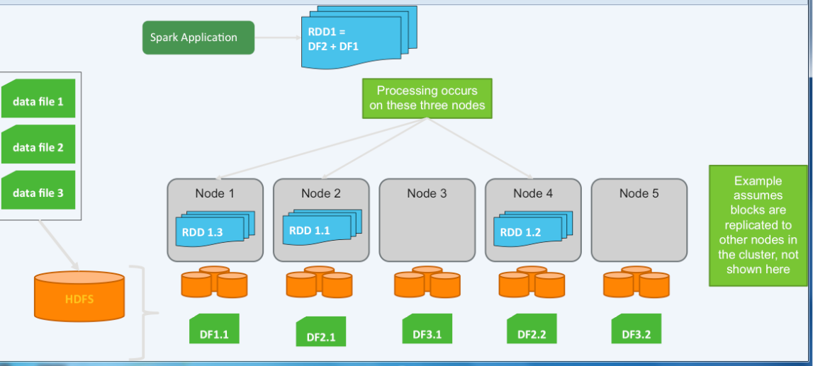
From Data Files to HDFS to RDD
Spark application that initially defines an RDD that is made up of a combination of the data in data files 1 and 2. In HDFS, these two files are represented by three HDFS blocks on nodes 1, 2, and 4.

Slide 15
When the RDD partitions are created in memory, the nodes that will be used will be nodes that contain the data blocks in order to improve performance and reduce the network traffic that would result from pulling data from one node’s disk to another node’s memory.
The three data blocks that represent these two files that were combined by the Spark application are then copied into memory on their respective nodes and become the partitions of the RDD.
DF2.1 is written to an RDD partition we have labeled RDD 1.1. DF2.2 is written to an RDD partition we have labeled RDD 1.2. DF1.1 is written to an RDD partition we have labeled RDD 1.3.
Thus, in our example, one RDD was created from two files (which are split across three HDFS data nodes), which exist in memory as three partitions which a Spark application can then continue to use.

Slide 16
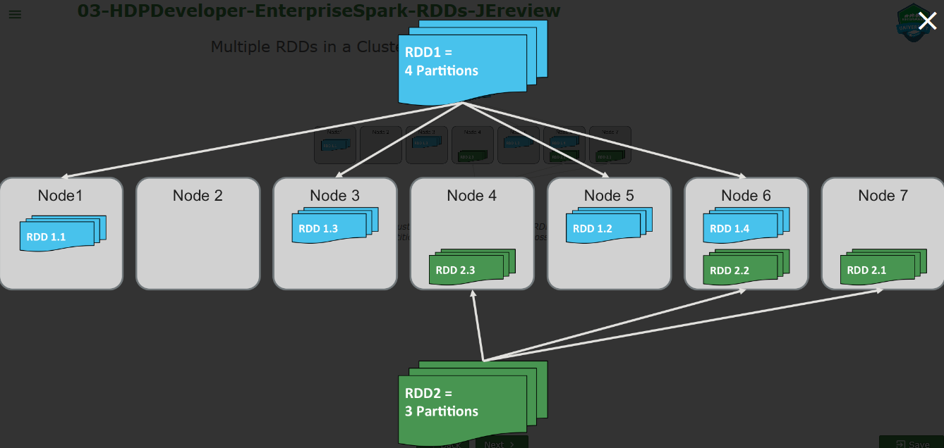
A hypothetical cluster that has two RDD's. Each RDD is composed of multiple partitions, which are distributed across the cluster
RDDs can contain any type of serializable element, meaning those that can be converted to and from a byte stream. Examples include: int, float, bool, and sequences/iteratives like arrays, lists, tuples, and strings. Element types in an RDD can be mixed as well. For example, an array or list can contain both string and int values. Furthermore, RDD types are converted implicitly when possible, meaning there is no need to explicitly specify the type during RDD creation.

Slide 17
RDD Operations
Once an RDD is created, there are two operations that can be performed on it: Actions and Transformations.
Transformations take an existing RDD, applies a function to the elements of the RDD, and creates a new RDD comprised of the transformed elements.
An action returns a result of a function applied to the elements of an RDD in the form of screen output, a file write, etc.

Slide 18
Spark Programming Basics
Spark makes heavy use of functional programming, programming that does not rely on data outside of the function being executed, nor does it modify data that exists outside of the current function
In this function, we define a variable value outside of our function, then pull that value into our function and modify it. Note the dependence on and the writing to a variable that exists external to the function itself:
varValue = 0 def unfunctionalCode(): global varValue varValue = varValue + 1
this time written using functional programming principles. In this example, the variable value is instantiated as part of calling the function itself, and only the value within the function is modified.
def functionalCode(varValue): return varValue + 1

Slide 19
The need to operate on different partitions of the same RDD in parallel makes functional programming a requirement for Spark. Thus, Spark programming has the following characteristics:
Immutable data: RDD1A can be transformed into RDD1B, but an individual element within RDD1A cannot be independently modified.
No state or side effects: No interaction with or modification of any values or properties outside of the function.
Behavioural consistency: If you pass the same value into a function multiple times, you will always get the same result - changing order of evaluation does not change results.
Functions as arguments: function results (including anonymous functions) can be passed as input/arguments to other functions.
Lazy evaluation: function arguments are not evaluated / executed until required.

Slide 20
Anonymous (a.k.a. Lambda) Functions
Anonymous functions, also known as Lambda functions, are used heavily in Spark programming. They start with a declaration of the anonymous function by using the keyword lambda. Then, the programmer provides the variable name that will be used in the function body, followed by a colon. To the right of the colon will be the function body, which can be a function definition or a call to yet another function.
Here is an example using "z" as the anonymous function variable selected and applying z+1 to all elements of an RDD as an argument to the Spark map function:
rddNumList = sc.parallelize([5, 7, 11, 14]) rddAnon = rddNumList.map(lambda z: z + 1) rddAnon.collect() [6, 8, 12, 15]

Slide 21
Basic Spark Transformations
map() :- The map transformation applies a function supplied as its argument to each element of an RDD
we have a list of numbers that make up our RDD. We then apply the map function and instruct Spark to run the anonymous function (using z as the variable name for each element) z+1, an immediately print the output to the screen:
rddNumList = sc.parallelize([5, 7, 11, 14]) rddNumList.map(lambda z: z + 1).collect() [6, 8, 12, 15]

Slide 22
Maps can apply to strings as well. Here is an example that starts by reading a file from HDFS called “Amarnath.txt":
rddAmarnath = sc.textFile(“Amarnath.txt”)
Amarnath was training Hadoop he wanted to make spark easy to his trainees
Everything is going well as per the plan
They are all desperate and committed
RDDs created using the textFile method treat newline characters as characters that separate elements. Thus, since the file had four lines, the file as shown in the image would have four elements in the RDD. rddLineSplit=rddAmarnath.map(lambda line: line.split(" "))
A map() transformation is then called. The goal of the map transformation in this scenario is to take each element, which is a string containing multiple words, and break it up into an array that is stored in a new RDD for further processing. The split function takes a string and breaks it into arrays based on the delimiter passed into split(). The result is an RDD which still only has four elements, but now those elements are arrays rather than monolithic strings.

Slide 23
flatMap() :-
The flatMap function is similar to map, with the exception that it performs an extra step to break down (or flattens) the component parts of elements such as arrays or other sequences into individual elements after running a map function.
map is a one to one transformation: one element comes in, one element comes out. Using map(), four line elements were converted into four array elements, but we still started and ended with the same number of elements. The flatMap function, on the other hand, is a one to possibly many transformation: one element may go in, but many can come out
rddLineAmarnath= rddAmarnath.map(lambda line: line.split(" "))
rddFlat = rddAmarnath.flatmap(lambda line: line.split(" "))
the output is returned as a single list of individual elements rather than four lists of elements that were originally separated by the line break.
This time, the results are each word being treated as its own element, resulting in 22 elements instead of 4. Again, it is easiest to think about flatMap() as simply a map operation followed by a flatten operation, in a single step

Slide 24
filter()
The filter function is used to remove elements from an RDD that don't pass a certain criteria, or put another way, only keeps elements in an RDD based on a predicate. If the predicate returns true (the filter criteria are met), the record is passed on to the transformed RDD.
rddNumList = sc.parallelize([5, 7, 11, 14]) rddNumList. Filter(lambda number: number <= 10).collect() [5, 7]
months = ["January", "March", "May", "July", "September"] rddMonths = sc.parallelize(months)
rddMonths.filter(lambda name: len(name) > 5).collect() ['January', 'September']
any available function that performs evaluations on text strings or arrays could be used to filter for a given result

Slide 25
distinct()
The distinct function removes duplicate elements from an RDD.
rddBigList = sc.parallelize([5, 7, 11, 14, 2, 4, 5, 14, 21]) rddBigList.collect() [5, 7, 11, 14, 2, 4, 5, 14, 21]
rddDistinct = rddBigList.distinct() rddDistinct.collect() [4, 5, 21, 2, 14, 11, 7]

Slide 26
Basic Spark Actions :-
collect(), first(), and take()
As we have already seen, the collect function returns the entire RDD on which it is run against. In addition, the first function returns just the first element in an RDD. The take function allows for the specification of a number of elements, and returns that number of elements when executed. Below are some examples of these functions in action:
rddNumList = sc.parallelize([5, 7, 11, 14]) rddNumList.collect() [5, 7, 11, 14] rddNumList.first() 5 rddNumList.take(2) [5, 7]

Slide 27
count()
count() returns the number of elements in the RDD. Here is an example:
rddNumList = sc.parallelize([5, 7, 11, 14]) rddNumList.count() 4
In the case of a file that contains lines of text, count() would return the number of lines in the RDD, as in the following example:
rddMary=sc.textFile(“Amarnath.txt")
rddMary.count() 4

Slide 28
reduce() :-
reduce() aggregates the elements of an RDD using a function that takes two arguments and returns one, iterating through them until only a single value remains
rddNumList = sc.parallelize([5, 7, 11, 14]) rddNumList.reduce(lambda a,b: a+b) => 37
Because of the parallelized nature of RDDs, the reduce function does not necessarily process RDD elements in a particular order.
Therefore, the function used with reduce() should be both commutative and associative.

Slide 29
Commutative means "to move around" - which implies that the order things are done in should not matter. For example, 5+7 = 7+5, or 5*7 = 7*5.
A function that is not commutative can return different results each time it is run. For example, 5 / 7 does not equal 7 / 5,
so a function that employed division would not be commutative.
Associative refers to the way numbers are grouped using parenthesis.
For example, 5 + (7 + 5) equals (5 + 7) + 5, or 5 * (7 * 5) = (5 * 7) * 5.
A function that is not associative can return different results each time it is run.
For example 5 * (7 + 5) does not equal (5 * 7) + 5, so this would not be associative.

Slide 30
saveAsTextFile() :-
The saveAsTextFile function writes the contents of RDD partitions to a specified location (such as hdfs:// for HDFS, file:/ for local file system, and so forth) and directory as a set of text files.
hdfs dfs -ls desiredLocation/foldername
rddNumList.saveAsTextFile("hdfs://desiredLocation/foldername")
Success can be verified using typical tools from a command line or GUI. In the case of our example, we could use the hdfs dfs -ls command to verify it had written successfully:

Slide 31
Transformations vs. Actions: Lazy Evaluation :-
Transformations are lazy, meaning they do not actually perform any computations until an action is performed.
Lazy evaluation prevents the processing of unneeded data. When a transformation alone is applied to an RDD, initially nothing happens.
The RDD just keeps track of all the transformations applied and will execute them when it’s necessary.
rddAmarnath = sc.textFile(“Amarnath.txt") rddFlat = rddAmarnath.flatmap(lambda line: line.split(" ")) rddFilter = rddFlat.filter(lambda words: len(words) > 4) rddFilter.count()
In the above code, two transformations were applied (flatMap and filter), but it was not until the count action is called that the RDD runs through the various transformations.

Slide 32
Multiple RDDs: union() and intersection()
To combine two RDDs, use the union function. This transformation is applied to an RDD and takes a second RDD as an argument, resulting in a third RDD that represents a combination of the two. For example, take the following two RDDs:
rddNumList = sc.parallelize([5, 7, 11, 14]) rddNumList2 = sc.parallelize([2, 4, 5, 14, 21])
rddCombined = rddNumList.union(rddNumList2)
rddCombined.collect() =>[5, 7, 11, 14, 2, 4, 5, 14, 21]
In other cases, an intersection is desired, a transformation in which only the values that exist in both RDDs make it into the output. You can create such an RDD and verify it
rddInter = rddNumList.intersection(rddNumList2) rddInter.collect() rddNumList.union(rddNumList2).collect() & rddNumList.intersection(rddNumList2).collect()

Slide 33
Named Functions
Custom functions can be defined and named, then used as arguments to other functions. A custom function should be defined when the same code will be used multiple times throughout the program, or if a function to be used as an argument will take more than a single line of code, making it too complex for an anonymous function.
The following example evaluates a number to determine if is 90 or greater. If so, it returns the text string "A" and if not it returns "Not an A".
def gradeAorNot(percentage): if percentage > 89: return "A" else: return "Not an A"

Slide 34
NOTE: In the REPL, the number of tabs matter. For example, in line 2, you have to tab once before typing the line, and in line 3 you must tab twice. In line 4, you have to tab once, and line 5, twice.
The custom named function gradeAorNot can then be passed as an argument to another function - for example, map().
rddGrades = sc.parallelize([87, 94, 41, 90]) rddGrades.map(gradeAorNot).collect() ['Not an A', 'A', 'Not an A', 'A']
The named function could also be used as the function body in an anonymous function. The following example results in equivalent output to the code above :-
rddGrades.map(lambda grade: gradeAorNot(grade)).collect()

Slide 35
Numeric Operations
Numeric operations can be performed on RDDs, including mean, count, stDev, sum, max, and min, as well as a stats function that collects several of these values with a single function. For example:
rddNumList = sc.parallelize([5, 7, 11, 14]) rddNumList.stats() (count: 4, mean: 9.25, stdev: 3.49…, max: 14, min: 5)
rddNumList.min() 5
NOTE: To double check the output of the Spark stdev() output in Excel, use Excel's stdevp function rather than the stdev function. Excel's stdev function assumes that the entire population is unknown, and thus makes adjustments to outputs based on assumed bias.
The stdevp function assumes the entire dataset (the p stands for "population") is fully represented and does not make a bias correction. Thus, Excel's stdevp function is more similar to Spark's stdev function.

Slide 36
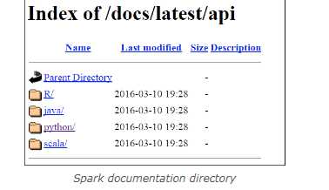
More Functions: Spark Documentation
There are many, many other Spark APIs available.
To learn more about them, you can access the Spark documentation.
Version can be and actual version number, such as "1.4.0" or "1.6.1", or alternatively you can use "latest" to view documentation on the newest release of Spark.
http://spark.apache.org/docs/latest/api/

Slide 37
Questions
What does RDD stand for? ﻿
What two functions were covered in this lesson that create RDDs? ﻿
True or False: Transformations apply a function to an RDD, modifying its values ﻿
Which transformation will take all of the words in a text object and break each of them down into a separate element in an RDD? ﻿
True or False: The count action returns the number of lines in a text document, not the number of words it contains. ﻿
What is it called when transformations are not actually executed until an action is performed? ﻿
True or False: The distinct function allows you to compare two RDDs and return only those values that exist in both of them ﻿
True or False: Lazy evaluation makes it possible to run code that "performs" hundreds of transformations without actually executing any of them

Slide 38
s
What does RDD stand for? Answer: Resilient Distributed Dataset ﻿
What two functions were covered in this lesson that create RDDs? Answer: sc.parallelize() and sc.textfile() ﻿
True or False: Transformations apply a function to an RDD, modifying its values Answer: False. Transformations result in new RDDs being created. In Spark, data is immutable. ﻿
Which transformation will take all of the words in a text object and break each of them down into a separate element in an RDD? Answer: flatmap() ﻿
True or False: The count action returns the number of lines in a text document, not the number of words it contains. Answer: True ﻿
What is it called when transformations are not actually executed until an action is performed? Answer: Lazy evaluation ﻿
True or False: The distinct function allows you to compare two RDDs and return only those values that exist in both of them Answer: False. The intersection function performs this task. The distinct function would remove duplicate elements, so that each element is only listed once regardless of how many times it appeared in the original RDD.

Slide 39
Summary :-
Resilient Distributed Datasets (RDDs) are immutable collection of elements that can be operated on in parallel
Once an RDD is created, there are two things that can be done to it: transformations and actions
Spark makes heavy use of functional programming practices, including the use of anonymous functions
Common transformations include map(), flatmap(), filter(), distinct(), union(), and intersection()
Common actions include collect(), first(), take(), count(), saveAsTextFile(), and certain mathematic and statistical functions

Slide 40
Pair RDD Introduction :-
Key-value Pair RDDs (a.k.a. just "Pair RDDs") are made up of elements comprised of key-value pairs. By creating Pair RDDs in Spark, developers gain access to additional API functionality.
This provides the developer with the capability to directly interact with RDD data in much the same way they might interact with data using Hive on Spark, Spark on Hive, or Spark SQL.

Slide 41
We are first creating an RDD from a file called “Amarnath.txt" and then calling a flatMap. Once each word is now its own element, key-value pairs can be created
rdd = sc.textFile("filelocation/Amarnath.txt") rddFlat = rdd.flatMap(lambda line: line.split(' '))
A map transformation can be used to create the key-value pair. In this process, a function is passed to map() to create a tuple. In the example below, we create an anonymous function which returns a tuple of (word,1).
kvRdd = rddFlat.map(lambda word: (word,1)) kvRdd.collect()

Slide 42
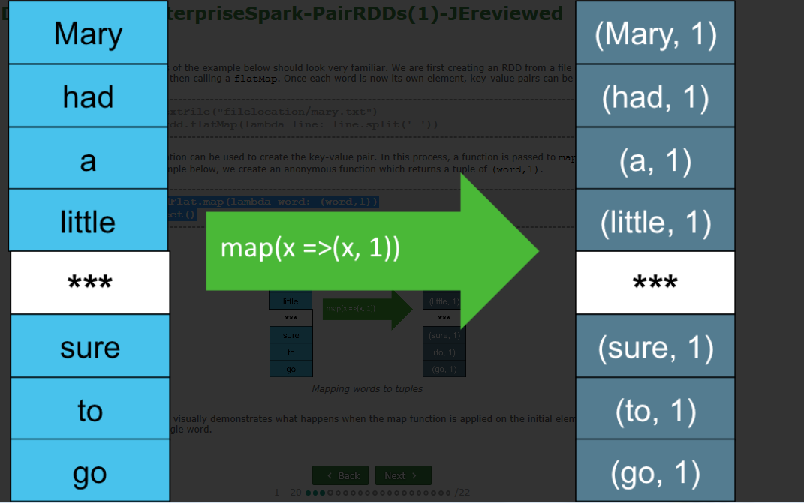
The picture here is visually demonstrates what happens when the map function is applied on the initial elements each consisting of a single word.

Slide 43
keyBy() :-
The keyBy API creates key-value pairs by applying a function on each data element. The function result becomes the key, and the original data element becomes the value in the pair.
rddTwoNumList = sc.parallelize([(1,2,3),(7,8)]) keyByRdd = rddTwoNumList.keyBy(len) keyByRdd.collect() [(3,(1,2,3)),(2,(7,8))]
rddThreeWords = sc.parallelize(["cat","A","spoon"]) keyByRdd2 = rddThreeWords.keyBy(len) keyByRdd2.collect() [(3,'cat'),(1,'A'),(5,'spoon')]

Slide 44
zipWithIndex()
The zipWithIndex function creates key-value pairs by assigning the index, or numerical position, of the element as the value, and the element itself as the key.
rddThreeWords = sc.parallelize(["cat","A","spoon"]) zipWIRdd = rddThreeWords.zipWithIndex() zipWIRdd.collect() [('cat', 0), ('A', 1), ('spoon', 2)]
zip()
The zip function creates key-value pairs by taking elements from one RDD as the key and elements of another RDD as the value. It has the following syntax:
rddThreeWords = sc.parallelize(["cat", "A", "spoon"]) rddThreeNums = sc.parallelize([11, 241, 37]) zipRdd = rddThreeWords.zip(rddThreeNums) zipRdd.collect() [('cat', 11), ('A', 241), ('spoon', 37)]

Slide 45
mapValues()
The mapValues function performs a defined operation on the values in a Pair RDD while leaving the keys unchanged. For example:
zipWIRdd = sc.parallelize([("cat", 0), ("A", 1), ("spoon", 2)]) rddMapVals = zipWIRdd.mapValues(lambda val: val + 1)
rddMapVals.collect() [('cat', 1), ('A', 2), ('spoon', 3)]
rddMapVals.keys().collect() ['cat', 'A', 'spoon']
rddMapVals.values().collect() [1, 2, 3]
rddMapVals.sortByKey().collect() [('A', 2), ('cat', 1), ('spoon', 3)]
NOTE: Without creating a PairRDD prior to using these functions, they will not work as expected.

Slide 46
Pair RDD Operations

Slide 47
Reorder Key-Value Pairs using map() :-
To reorder the placement of elements in key-value pairs, you can use pattern matching available via the map function.
The example below demonstrates how to take a simple Pair RDD and switch the order such that the key is now the value, and the value becomes the key:
zipWIRdd = sc.parallelize([("cat", 0), ("A", 1), ("spoon", 2)]) rddReorder = zipWIRdd.map(lambda (key, value): (value, key)) rddReorder.collect() [(0, 'cat'), (1, 'A'), (2, 'spoon')]
rddKeyTwoVal = sc.parallelize([("cat", (0,1)), ("spoon", (2,3))]) rddK2VReorder = rddKeyTwoVal.map(lambda (key, (val1, val2)) : ((key, val1) , val2)) rddK2VReorder.collect() [(('cat', 0), 1), (('spoon', 2), 3)]
This can be useful when you want to use a function that is designed to work on a key (for example, the sortByKey function), but have it applied to a value instead.

Slide 48
keys(), values(), and sortByKey() :-
Some common functions to call when working with Pair RDDs include keys(), values(), and sortByKey().
We will explore them using the rddMapVals Pair RDD we created in the previous example:
zipWIRdd = sc.parallelize([("cat", 0), ("A", 1), ("spoon", 2)]) rddMapVals = zipWIRdd.mapValues(lambda val: val + 1) rddMapVals.collect() [('cat', 1), ('A', 2), ('spoon', 3)]
keys() - returns a list of just the keys in the RDD without any values.
sortByKey(ascending=False) - sorts the RDD alphanumerically by key. By default, will sort from smallest to largest value (ascending=True). If ascending is explicitly set to False, it orders from largest to smallest.

Slide 49
lookup(), countByKey(), and collectAsMap() :-
There are many other functions available for Pair RDD transformations and actions. We will go back to the keyByRdd example created earlier to discuss lookup(), countByKey(), and collectAsMap
rddTwoNumList = sc.parallelize([(1,2,3),(7,8)]) keyByRdd = rddTwoNumList.keyBy(len) keyByRdd.collect() [(3, (1, 2, 3)), (2, (7, 8))]
lookup(key) - returns a list containing all values for a given key.
keyByRdd.lookup(2) [(7, 8)]
countByKey() - returns a count of the number of times each key appears in the RDD (in our example, there were no duplicate keys, so each is returned as
keyByRdd.countByKey() defaultdict(<type 'int'>,{2: 1, 3: 1})
collectAsMap() - collects the result as a map.
If multiple values exist for the same key only one will be returned.
keyByRdd.collectAsMap() {2: (7, 8), 3: (1, 2, 3)}

Slide 50
reduceByKey() :-
The reduceByKey function performs a reduce operation on all elements of a key/value pair RDD that share a key. For our example here, we'll return to kvRdd that was created using the following code:
rddAmarnath = sc.textFile("filelocation/Amarnath.txt") rddFlat = rddAmarnath.flatMap(lambda line: line.split(' ')) kvRdd = rddFlat.map(lambda word: (word,1))
kvReduced = kvRdd.reduceByKey(lambda a,b: a+b)
The reduceByKey function goes through the elements and if it sees a key that it hasn't already encountered, it adds it to the list and records the value as-is.

Slide 51
If a duplicate key is found, reduceByKey performs a function on the key values and keeps the number of keys to one.
In our example, then, the anonymous function "lambda a,b: a+b“ only kicks in if a duplicate key is found. If so, the anonymous function tells reduceByKey to take the values of the two keys (a and b) and add them together to compute a new value for the now-reduced key.
The actual function being performed is up to the developer, but incrementally adding values would be a fairly common task

Slide 52
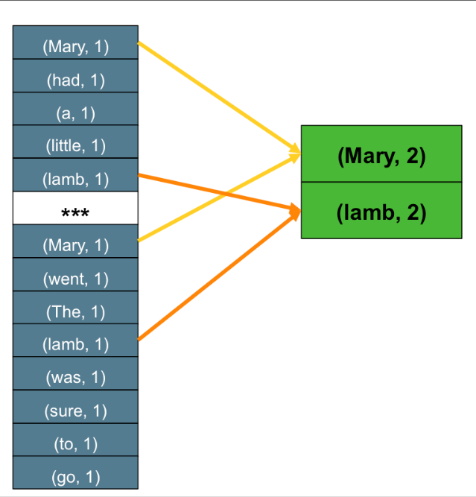
what is happening is the elements of the RDD are being recorded and passed to the new kvReduced RDD, with the exception of two keys - 'Mary' and 'lamb' - which were both found twice. All other values remain unchanged, but now 'Mary' and 'lamb' are reduced to single key, each with a value of 2

Slide 53
groupByKey() :-
Grouping values by key allow us to aggregate values based on a key. In order to see this grouping, the results must be turned into a list before being collected.
For example, let's again use our kvRdd example created with the following code:
rddAmarnath = sc.textFile("filelocation/Amarnath.txt") rddFlat = rddAmarnath.flatMap(lambda line: line.split(' ')) kvRdd = rddFlat.map(lambda word: (word,1))
we will use groupByKey to group all values that have the same key into an iterable object (that is, on its own, unable to be viewed) and then use a map function to define these grouped elements into a readable list:

Slide 54
If we had simply generated output using groupByKey alone, as below:
This tells you that the results are an object which allows iteration, but does not display the individual elements by default. Using map to list the elements performed the necessary iteration to be able to see the desired formatted results.
kvGroupByKey = kvRdd.groupByKey()
when we ran the code to collect the results, the output would have looked something like this:
[(u'a', <pyspark.resultiterable.ResultIterable object at 0xde8450>), (u'lamb', <pyspark.resultiterable.ResultInterable object at 0xde8490>),…(u'Mary', <pyspark.resultiterable.ResultIterable object at 0xde8960>)]
NOTE: The groupByKey and reduceByKey functions have significant overlap and similar capabilities, depending on how the called function is defined by the developer. When either is able to get the desired output, it is better to use reduceByKey() as it is more efficient over large datasets.

Slide 55
flatMapValues():-
Like the mapValues function, the flatMapValues function performs a function on Pair RDD values, leaving the keys unchanged.
However, in the event it encounters a key that has multiple values, it flattens those into individual key-value pairs, meaning no key will have more than one value, but you will end up with duplicate keys in the RDD.
kvGroupByKey = kvRdd.groupByKey().map(lambda x : (x[0], list(x[1]))) kvGroupByKey.collect() [(u'a', [1]), (u'lamb', [1, 1]),(u'little', [1]),…(u'Mary',[1, 1])]

Slide 56
Notice that both the 'lamb' and 'Mary' keys contain a multiple key values in a list.
Next, let's create an RDD that flattens those key-value pairs using the flatMapValues function:
rddFlatMapVals = kvGroupByKey.flatMapValues(lambda val: val) rddFlatMapVals.collect() [(u'a', 1), (u'lamb', 1), (u'lamb', 1), (u'little', 1), … (u'Mary',1), (u'Mary',1)]
NOTE:
In the example above, the anonymous function simply returns the original unedited value. However, like the mapValues function, flatMapValues() can be configured to modify the keys as it flattens out the key-value pairs.
For example, if we had defined the anonymous function as: (lambda val: val + 1), then each of the values would have been returned as 2 instead of 1.

Slide 57
subtractByKey() :-
The subtractByKey function will return key-value pairs containing keys not found in another RDD.
This can be useful when you need to identify differences between keys in two RDDs. Here is an example :-
zipWIRdd = sc.parallelize([("cat", 0), ("A", 1), ("spoon", 2)]) rddSong = sc.parallelize([("cat", 7), ("cradle", 9), ("spoon", 4)]) rddSong.subtractByKey(zipWIRdd).collect() [('cradle', 9)]
The key-value pair that had a key of 'cradle' was the only one returned because both RDDs contained key-value pairs that had key values of 'cat' and 'spoon‘

Slide 58
Note that ('A', 1) was not returned as part of the result. This is because subtractByKey() is only evaluating matches in the first RDD (the one that precedes the function) as compared to the second one.
It does not return all keys in either RDD that are unique to that RDD. If you wanted to get a list of all unique keys for both RDDs using subtractByKey(), you would need to run the operation twice - once as shown, and then again, swapping out the two RDD values in the last line of code.
zipWIRdd.subtractByKey(rddSong).collect() [('A', 1)]
If needed, you could store these outputs in two other RDDs, then use another function to combine them into a single list as desired

Slide 59
Pair RDD Joins :-
Spark provides support for inner, full outer, left outer, and right outer joins when working with Pair RDDs. Here is an example of using leftOuterJoin():
zipWIRdd = sc.parallelize([("cat", 0), ("A", 1), ("spoon", 2)]) rddSong = sc.parallelize([("cat", 7), ("cradle", 9), ("spoon", 4)]) rddSong.leftOuterJoin(zipWIRdd).collect() [('spoon', (4, 2)), ('cradle', (9, none)), ('cat', (7, 0))]

Slide 60
Questions :-
An RDD that contains elements made up of key-value pairs is sometimes referred to as a _________________. ﻿
Name two functions that can be used to create a Pair RDD. ﻿
True or False: A key can have a value that is actually a list of many values. ﻿
Since sortByKey() only sorts by key, and there is no equivalent function to sort by values, how could you go about getting your Pair RDD sorted alphanumerically by value? ﻿
You determine either reduceByKey() or groupByKey() could be used in your program to get the same results. Which one should you choose? ﻿
How can you use subtractByKey() to determine *all* of the unique keys across two RDDs?

Slide 61
Answers :-
An RDD that contains elements made up of key-value pairs is sometimes referred to as a _________________. Answer: Pair RDD ﻿
Name two functions that can be used to create a Pair RDD. Answer: map(), keyBy(), zipWithIndex(), zip() ﻿
True or False: A key can have a value that is actually a list of many values. Answer: True ﻿
Since sortByKey() only sorts by key, and there is no equivalent function to sort by values, how could you go about getting your Pair RDD sorted alphanumerically by value? Answer: First use map() to reorder the key-value pair so that the key is now the value. Then use sortByKey() to sort. Finally, use map() again to swap the keys and values back to their original positions. ﻿
You determine either reduceByKey() or groupByKey() could be used in your program to get the same results. Which one should you choose? Answer: reduceByKey(), because it is more efficient - especially on large datasets. ﻿
How can you use subtractByKey() to determine *all* of the unique keys across two RDDs? Answer: Run it twice, switching the order of the RDDs each time.

Slide 62
Summary :-
Pair RDDs contain elements made up of key-value pairs
Common functions used to create Pair RDDs include map(), keyBy(), zipWithIndex(), and zip()
Common functions used with Pair RDDs include mapValues(), keys(), values(), sortByKey(), lookup(), countByKey(), collectAsMap(), reduceByKey(), groupByKey(), flatMapValues(), subtractByKey(), and various join types

Slide 63
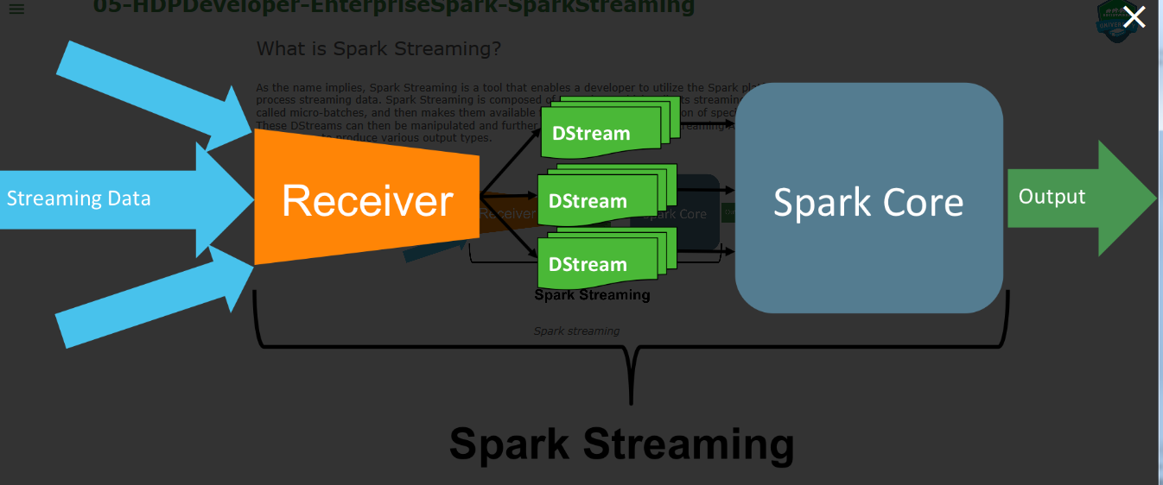
What is Spark Streaming?
As the name implies, Spark Streaming is a tool that enables a developer to utilize the Spark platform to ingest and process streaming data.
Spark Streaming is composed of a receiver, which collects streaming data in small amounts called micro-batches, and then makes them available for processing via a collection of specialized RDDs called a DStream.
These DStreams can then be manipulated and further processed via the Spark Streaming API, which is an extension of Spark Core, to produce various output types.

Slide 64
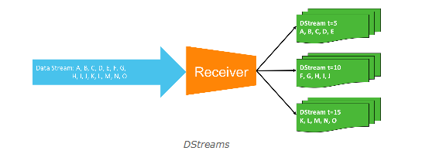
Dstreams :-
A DStream is a collection of one or more specialized RDDs divided into discrete chunks based on time interval.
When a streaming source communicates with Spark Streaming, the receiver caches information for a specified time period, after which point the data is converted into a DStream and available for further processing.
Each discrete time period (in the example pictured, every five seconds) is a separate DStream.

Slide 65
DStream vs. RDD :-
DStreams have some differences compared to traditional RDDs. The first, and perhaps most consequential difference is that DStreams contain data and physically exist in memory from the moment of creation.
Traditional RDDs, on the other hand, are sets of instructions that don't actually contain in-memory data until an action is performed.
The second big difference is that, by default, DStreams only exist in memory until the next batch of data is ready to be processed.
A third, minor difference is terminology: while you perform transformations on both RDDs and DStreams, RDDs create results via "actions" whereas DStreams use similar "outputs."

Slide 66
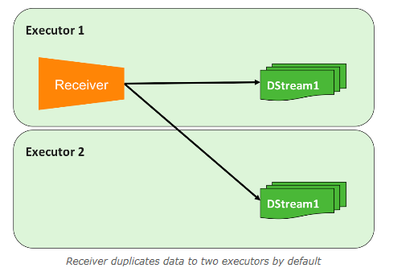
DStream Replication :-
DStreams are fault tolerant, meaning they are written to a minimum of two executors at the moment of creation. The loss of a single executor will not result in the loss of the DStream

Slide 67
Receiver Availability :-
By default, receivers are highly available. If the executor running the receiver goes down, the receiver will be immediately restarted in another executor.
Spark Streaming performs micro-batching rather than true bit-by-bit streaming. Collecting and processing data in batches can be more efficient in terms of resource utilization, but comes at a cost of latency and risk of small amounts of lost data.
Spark Streaming can be configured to process batch sizes as small as one second, which takes approximately another second to process, for a two-second delay from the moment the data is received until a response can be generated.
This introduces a small risk of data loss, which can be mitigated by the use of reliable receivers (available in the Scala and Java APIs only at the time of this writing) and intelligent data sources

Slide 68
Receiver Reliability :-
By default, receivers are "unreliable." This means there is:
No acknowledgment between receiver and source
No record of whether data has been successfully written
No ability to ask for retransmission for missed data
Possibility for data loss if receiver is losts
To implement a reliable receiver, a custom receiver must be created.
A reliable receiver implements a handshake mechanism that acknowledges that data has been received and processed.
Assuming the data source is also intelligent, it will wait to discard the data on the other side until this acknowledgement has been received, which also means it can retransmit it in the event of data loss.
Custom receivers are available in the Scala and Java Spark Streaming APIs only, and are not available in Python

Slide 69
Streaming Data Source Examples :-
Spark Streaming can receive data from multiple sources, both basic and advanced types.
Basic sources include monitoring HDFS directories and ingesting any new files that are created as streamed data, text streaming via a TCP socket connection, and even setting up queues of traditional RDDs that can be used to test a streaming application.
Advanced sources include Apache Kafka, Amazon Kinesis, Apache Flume, and MQTT.
NOTE: Additional data sources are available via the Scala and Java APIs

Slide 70
Basic Streaming :-
Next we will examine the basics of creating a data stream using Spark Streaming
StreamingContext
Spark Streaming extends the Spark Core architecture model by layering in a StreamingContext on top of the SparkContext.
The StreamingContext acts as the entry point for streaming applications.
It is responsible for setting up the receiver and enables real-time transformations on DStreams.
It also produces various types of output.

Slide 71
Modify REPL CPU Cores :-
When running streaming applications, it is usually beneficial to utilize multiple CPU cores.
Spark REPLs run programs on the local machine - which, in this course, is named "sandbox" - and are assigned to a single CPU core.
Spark Streaming application should have a number of cores equal to the number of DStreams being ingested plus a core for the receiver itself.
Thus, if you have 20 DStreams, you should have 21 CPU cores available for best performance.
This behavior can be changed by modifying the MASTER environment variable, which in the REPL can be done at launch. For example, to utilize two cores in pyspark

Slide 72
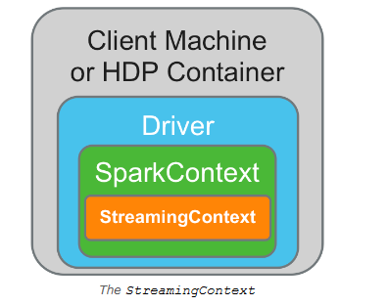
pyspark --master local[2]

Slide 73
Launch StreamingContext :-
To launch the StreamingContext, you first need to import the StreamingContext API. In pyspark, the code to perform this operation would be:
from pyspark.streaming import StreamingContext
Next, you create an instance of the StreamingContext. When doing so, you supply the name of the SparkContext in use, as well as the time interval (in seconds) for the receiver to collect data for micro-batch processing.
When using a REPL, the SparkContext will be named sc by default. For example, when creating an instance of StreamingContext named ssc, in the pyspark REPL, with a micro-batch interval of one second
ssc = StreamingContext(sc, 1)

Slide 74
This operation will return an error if the StreamingContext API has not been imported.
Both the name of the Spark Streaming instance and the time interval can be modified to fit your purposes. Here's an example of creating a StreamingContext instance with a 10-second micro-batch interval:
sscTen = StreamingContext(sc, 10)
It is important to note, that while multiple instances of StreamingContext can be defined, only a single instance of SparkContext can run per JVM.
Once running, another instance will fail to launch. In fact, once the current instance has been stopped, it cannot be launched again in the same JVM.
Thus, while the REPL is a useful tool for learning and perhaps testing Spark Streaming applications, in production it would be problematic because every time a developer wanted to test a slightly different application, it would require stopping and restarting the REPL itself.

Slide 75
Stream from HDFS Directories and TCP Sockets :-
To create a stream by monitoring an HDFS directory and ingesting any new files that appear, choose a variable name for the DStream, then call the textFileStream() function from the StreamingContext API and supply the full path to the appropriate HDFS directory. For example:
hdfsInputDS = ssc.textFileStream("someHDFSdirectory")
NOTE: If the HDFS directory exists on the cluster the application is attached to, only the path needs to be provided. If it exists on a separate cluster, prepend the path with "hdfs:/nodename:8020/…"
To create a stream by monitoring a TCP socket source, choose a variable name for the DStream, then call the socketTextStream() function and supply the source hostname or IP address (whichever is appropriate in your situation) and the port number to monitor. For example:
tcpInputDS = ssc.socketTextStream("someHostname", portNumber)
Note that in both examples, the name of the StreamingContext instance had to be specified before calling the function.
Otherwise, the application would have tried to call this from the default SparkContext, and since these functions to not exist outside of Spark Streaming, and error would have been returned.

Slide 76
Output to Console and to HDFS :-
s
To print streaming output to the console / terminal window, in Python use the "pretty print" function, pprint().
In Scala/Java the same function is simply named print().
Python: DSvariableName.pprint()
Scala/Java: DSvariableName.print()
When printing output to the console, we suggest setting the log level for the SparkContext to "ERROR" in order to reduce screen output.
Otherwise, lots of information besides what is being streamed will appear and clutter up the screen. To do this, use the SparkContext setLogLevel function as follows: sc.setLogLevel("ERROR")

Slide 77
To save the output as a time-stamped text file on HDFS, use the saveAsTextFiles function.
Make sure the application has write permissions to the HDFS directory selected. The syntax for this operation is:
DSVariable.saveAsTextFiles("HDFSlocation/prefix", "optionalSuffix")
The output will be generated on a per-DStream basis, with whatever you select as the prefix prepending the rest of the file name, which will be "-<timestamp>."
In addition, you can choose to add a suffix to each file as well, which will appear at the end of the file.
Prefixes and suffixes are useful, particularly if multiple data streams are being written to the same directory.
It is also noteworthy that these outputs are not exclusive.
You can choose to output to the console *and* to HDFS without issue.

Slide 78
Start and Stop the Streaming Application :-
With streaming applications, all operations must be defined before the stream is started.
Thus, the interactivity benefit of the REPL becomes lost.
Once all transformations and outputs have been defined, to launch a streaming application simply call the SparkContext instance and use the start function.
The application can be stopped in the same fashion using the stop function. For example:
When ready: ssc.start()
When finished: ssc.stop()
In a REPL, the streaming application will also stop if the terminal it is running in is closed.

Slide 79
Simple Streaming Program Example Using a REPL :-
# pyspark --master local[2] >>> sc.setLogLevel("ERROR") >>> from pyspark.streaming import StreamingContext >>> sscFive = StreamingContext(sc, 5) >>> hdfsInputDS = sscFive.textFileStream("/user/root/test/") >>> hdfsInputDS.saveAsTextFiles("/user/root/test/stream/name") >>> hdfsInputDS.pprint() >>> sscFive.start()
In this application, the pyspark REPL is called with the MASTER variable configured to use two CPU cores on the local machine.
The SparkContext log level is set to "ERROR", and then the StreamingContext API is imported. Then, an instance of StreamingContext named sscFive is created, with a micro-batch time interval of five seconds.
A DStream is defined using the textFileStream function to monitor the local HDFS directory /user/root/test/.
Those inputs are then output as text files with a prefix of "name" (no suffix is defined) to the local HDFS directory /user/root/test/stream/.
ssFinally, the inputs are also output to the console using pprint(). Then the application is launched.

Slide 80
sss
Transformations allow modification of DStream data to create new DStreams with different output.
DStream transformations are similar in nature and scope to traditional RDD transformations.
In fact, many of the same functions in Spark Core also exist in Spark Streaming. The following functions should look familiar:
map()
flatMap()
filter()
repartition()
union()
count()
reduceByKey()
join()

Slide 81
Transformation using flatMap() :-
As an example, here is a Spark Streaming application that utilizes the flatMap function and prints output to the console.
# pyspark --master local[2] >>> sc.setLogLevel("ERROR") >>> from pyspark.streaming import StreamingContext >>> ssc = StreamingContext(sc, 5) >>> hdfsInputDS = ssc.textFileStream("someHDFSdirectory") >>> flatMapDS = hdfsInputDS.flatMap(lambda line: line.split(" ") >>> flatMapDS.pprint() >>> ssc.start()
Note that the first five lines of code are similar to the application example from the previous section.
In this example, then, the original DStream transformed into a new DStream named flatMapDS, and the new DStream is output to the console

Slide 82
Combine DStreams using union() :-
The union function also works in the same way as it does with traditional RDDs. In this example, we create two DStreams and combine them with union().
sNote that we used the same HDFS location in the example, so the output would simply be the same input written twice.
# pyspark --master local[2] >>> sc.setLogLevel("ERROR") >>> from pyspark.streaming import StreamingContext >>> ssc = StreamingContext(sc, 5) >>> input1 = ssc.textFileStream("/user/root/test/") >>> input2 = ssc.textFileStream("/user/root/test/") >>> combined = input1.union(input2) >>> combined.pprint() >>> ssc.start()

Slide 83
Create Key-Value Pairs :-
Similarly to traditional RDDs, DStreams can be transformed into key-value pairs using flatMap() followed by map().
Here's an example:
# pyspark --master local[2] >>> sc.setLogLevel("ERROR") >>> from pyspark.streaming import StreamingContext >>> ssc = StreamingContext(sc, 5) >>> hdfsInputDS = ssc.textFileStream("someHDFSdirectory") >>> kvPairDS = hdfsInputDS.flatMap(lambda line: line.split(" ").map(lambda word: (word, 1)) >>> kvPairDS.pprint() >>> ssc.start()

Slide 84
reduceByKey() :-
And again, like traditional RDDs, key-value pair DStreams can be reduced using the reduceByKey function.
# pyspark --master local[2] >>> sc.setLogLevel("ERROR") >>> from pyspark.streaming import StreamingContext >>> ssc = StreamingContext(sc, 5) >>> hdfsInputDS = ssc.textFileStream("someHDFSdirectory") >>> kvPairDS = hdfsInputDS.flatMap(lambda line: line.split(" ").map(lambda word: (word, 1)) >>> kvReduced = kvPairDS.reduceByKey(lambda a,b: a+b) >>> kvReduced.pprint() >>> ssc.start()
This coding pattern is often used to write word count applications.

Slide 85
Stateful vs. Stateless Operations :-
As previously discussed, by default DStreams are discarded from memory when the next batch of data arrives.
This behavior is fine assuming all operations / transformations are performed are on single DStreams, which are not dependent on previous data.
This mode of operation is referred to as working with "stateless" operations / transformations.
However, it is sometimes beneficial or necessary to perform transformations and gather output across overlapping time slices, or even across an entire collected dataset.
For example, you might want to compute a running average every 15 seconds using the last 45 seconds worth of data. This is referred to as working with "stateful" operations / transformations.

Slide 86
Checkpointing :-
Checkpointing is used in stateful streaming operations to maintain state in the event of system failure.
To enable checkpointing, you can simply specify an HDFS directory to write checkpoint data to using the checkpoint function. For example:
ssc.checkpoint("someHDFSdirectory")
Trying to write a stateful application without specifying a checkpoint directory will result in an error once the application is launched.

Slide 87
Questions :-
Name the two new components added to Spark Core to create Spark Streaming. ﻿
If an application will ingest three streams of data, how many CPU cores should it be allocated? ﻿
Name the three basic streaming input types supported by both Python and Scala APIs. ﻿
What two arguments does an instance of StreamingContext require? ﻿
What is the additional prerequisite for any stateful operation? ﻿
What two parameters are required to create a window?

Slide 88
Answers :-
Name the two new components added to Spark Core to create Spark Streaming. Answer: Receivers and DStreams. StreamingContext is also an acceptable answer here. ﻿
If an application will ingest three streams of data, how many CPU cores should it be allocated? Answer: Four - one for each stream, and one for the receiver. ﻿
Name the three basic streaming input types supported by both Python and Scala APIs. Answer: HDFS text via directory monitoring, text via TCP socket monitoring, and queues of RDDs. ﻿
What two arguments does an instance of StreamingContext require? Answer: The name of the SparkContext and the micro-batch interval. ﻿
What is the additional prerequisite for any stateful operation? Answer: Checkpointing. ﻿
What two parameters are required to create a window? Answer: Window duration and collection/sliding interval.

Slide 89
Summary :-
Spark Streaming is an extension of Spark Core that adds the concept of sa streaming data receiver and a specialized type of RDD called a DStream.
DStreams are fault tolerant, whereas receivers are highly available.
Spark Streaming utilizes a micro-batch architecture.
Spark Streaming layers in a StreamingContext on top of the Spark Core SparkContext.
Many DStream transformations are similar to traditional RDD transformations
Window functions allow operations across multiple time slices of the same DStream, and are thus stateful and require checkpointing to be enabled.

Slide 90
SPARK PERFORMANCE TUNING

Slide 91
Explain why mapPartitions usually performs better than maps
Describe how to repartition RDDs and how this can improve performance
Explain the different caching options available
Describe how checkpointing can reduce recovery time in the event of loosing an executor.
Describe situations where broadcasting increases runtime efficiencies
Detail the options available for configuring executors
Explain the purpose and function of YARN.

Slide 92
mapPartitions() vs. map() :-
mapper transformations are narrow operations which benefit from partitions being operated on independently from each other.
The mapPartitions API is a special kind of map transformation that can be used when both the inputs and outputs are iterable.
It operates at the RDD partition level.
The map API, in contrast, operates at the element level.
You want to initialize a database connection when mapping an RDD that contains 2,000,000 elements and is spread across four RDD partitions.
If we use the map API to accomplish this, each element will require a database connection to be made which results in 2,000,000 initializations.
However, if we use the mapPartitions API, each whole partition gets sent to the mapper’s function at once, resulting in only four database connection initializations.
Once initialized, the elements in the partition can then be iterated through and transformed.
This reduction in the number of initializations that must take place can result in significantly improved performance.

Slide 93
rdd1 = sc.parallelize((1,2,3,4,5,6,7,8),2) rdd1.mapPartitions(lambda x: [sum(x)]).collect() [(10, 26)]
The first line creates rdd1 as an iterable list of numbers, and tells Spark to split this into two partitions.
The next line uses mapPartitions() to sum the values in each partition and return the individual results.
If these results needed to be further combined, the output could have been saved as a new RDD by changing the second line as follows:
rdd2 = rdd1.mapPartitions(lambda x: [sum(x)])

Slide 94
The brackets around sum(x) are required in this example because the input *and* output of mapPartitions() must be iterable.
Without the brackets to keep the individual partition values separate, the function would attempt to return a number rather than a list of results, and as such would fail.
If the total sum was needed, you would need to perform an additional operation on rdd2 (from the modification to line 2 above)
rdd1.mapPartitions(lambda x: [sum(x)]).reduce(lambda a,b: a+b) #
or just
rdd1.reduce(lambda a,b: a+b) in the first place if not trying to explain mapPartitions

Slide 95
RDD Parallelism :-
The cornerstone of performance in Spark centre's around the concepts of narrow and wide operations.
How RDDs are partitioned, initially and via explicit changes, can make a significant impact on performance.
Inherent Parallelism – parallelize() :-
If a dataset has no parent, such as from an sc.parallelize() operation, then the total number of CPU cores across all the executor YARN containers for the full Spark application is used unless the value is less than two (the minimum number of partitions).
The spark.default.parallelism property could be set (http://spark.apache.org/docs/latest/configuration.html) for each application to override this.

Slide 96
Spark’s goal of aligning the RDD’s number of partitions to that of the cores available is based on the intention of making sure no resources are idle when an operation on the RDD is being performed.
partitions that have a small number of elements, or in extreme cases, no elements. Depending on circumstances, this can either improve or hurt performance.
The parallelize operation can take an optional parameter to make the number of partitions larger or smaller than the default value for the application.
sc.defaultParallelism 4 rdd1 = sc.parallelize((1,2,3,4,5,6)) rdd1.getNumPartitions() 4 rdd1 = sc.parallelize((1,2,3,4,5,6),numSlices=8) rdd1.getNumPartitions() 8 rdd1 = sc.parallelize((1,2,3,4,5,6),2) rdd1.getNumPartitions() 2

Slide 97
Inherent Parallelism – textFile()
Default parallelism aligns with the number of blocks the file(s) take up on the HDFS when using textFile.
If the file is only one block in size, the RDD will be created with the minimum size of two partitions. s
This can be increased by providing a second optional argument declaring the number of partitions preferred.
This number cannot be less than the number of HDFS blocks, but this will not surface and error.
Instead, it will just be created with the number of partitions equal to the number of blocks.

Slide 98
HDFS default block size of 128MB is being easily accounted for as an RDD partition size.
Furthermore, Spark can more quickly create the RDD by reading a single HDFS block and creating two, or more, RDD partitions from it than it can read from multiple HDFS partitions (usually on separate worker nodes) to create a single RDD partition.
Here is an example of creating an RDD from a one-block HDFS file.
rdd1 = sc.textFile("statePopulations.csv") rdd1.getNumPartitions() 2 rdd1 = sc.textFile("statePopulations.csv", minPartitions=4) rdd1.getNumPartitions() 4 rdd1 = sc.textFile("statePopulations.csv", 1) rdd1.getNumPartitions() 1
Notice that it defaults to two partitions, but can be created with only one since the number of blocks used is also one.

Slide 99
trying to reduce the number of partitions to a value smaller than the number of blocks does not produce an error but simply sets it to the minimum size based on the number of blocks.
As with parallelize, the goal is still to have enough RDD partitions to allow for all executors to be working during operations; especially narrow ones.
The reverse can happen with a small HDFS file compared with parallelize.
A small file will take up few partitions. Generally speaking, you should increase this number on smaller files to be more inline with the number of cores available.

Slide 100
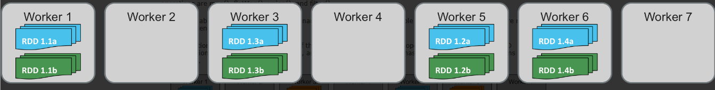
Narrow Dependencies/Operations :-
Narrow operations can be executed locally and do not depend on any outside the current element.
Examples of narrow operations are map(), flatMap(), union(), and filter().
Narrow Dependencies/Operations with map(), flatMap() or filter()
As visible in the picture above, there are no interdependencies between partitions.
Transformations maintain the partitioning of the largest parent RDD for the operation.
For single parent RDD transformations, including filter(), flatMap(), and map(), the resulting RDD has the same number of partitions as the parent RDD

Slide 101
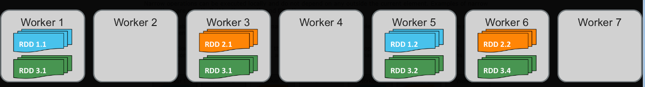
For combining transformations such as union(), the number of resulting partitions will be equal to the total number of partitions from the parent RDDs
Narrow Dependencies/Operations with union()
Transformations maintain the partitioning of the largest parent RDD for the operation.
For single parent RDD transformations, including filter(), flatMap(), and map(), the resulting RDD has the same number of partitions as the parent RDD.

Slide 102
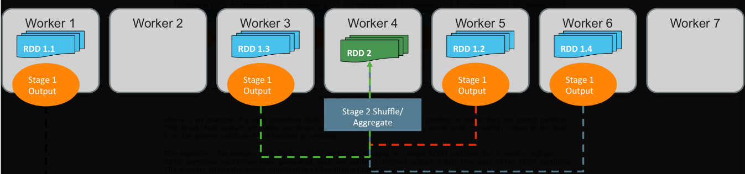
Wide Dependencies/Operations :-
Wide operations occur when shuffling of data is required. Examples of wide operations are reduceByKey(), groupByKey(), repartition(), and join()
Note that the child partitions are dependent on more than one parent partition.
This should help explain why wide operations separate stages.
The child RDD cannot exist completely unless all the data from the parent partitions have finished processing

Slide 103
The example in the image shows the four RDD1 partitions reducing to a single RDD2 partition, but in reality multiple RDD2 partitions would have been generated, each one pulling a different subset of data from each of the RDD1 partitions.
The diagram shows the logical combination rather than a physical result.
All shuffle-based operations’ outputs use the number of partitions that are present in the parent with the largest number of partitions.
In the diagram above this would have resulted in RDD2 being spread across four partitions.
Again, it was shown as a single partition to help visualize what is happening and to prevent an overly complicated diagram

Slide 104
The developer can specify the number of partitions the transformation will use, instead of defaulting to the larger parent.
This is shown by passing a numPartitions as an optional parameter, as shown in the following two versions of the same operation.
reduceByKey(lambda c1,c2: c1+c2, numPartitions=4)
reduceByKey(lambda c1,c2: c1+c2, 4)

Slide 105
Controlling Parallelism :-
The following RDD transformations allow for partition-number changes:
distinct(), groupByKey(), reduceByKey(), aggregateByKey(), sortByKey(), join(), cogroup(), coalesce(), and repartition().
The larger the number of partitions, the more parallelization the application can achieve.
There are two operations for manually changing the partitions without using a shuffle-based transformation: repartition() and coalesce().
A repartition() operation will shuffle the entire dataset across the network.
A coalesce() just shuffles the partitions that need to be moved

Slide 106
Coalesce should only be used when reducing the number of partitions :-
Use reparition() to change the number of partitions to 500: rdd.repartition(500) Use coalesce() to reduce the number of partitions to 20: rdd.coalesce(20)
Changing Parallelism During a Transformation :-
sc.textFile("statePopulations.csv").map(lambda line: line.split(",")).map(lambda rec: (rec[4],int(rec[5]))).reduceByKey(lambda c1,c2: c1+c2, numPartitions=2).collect()

Slide 107
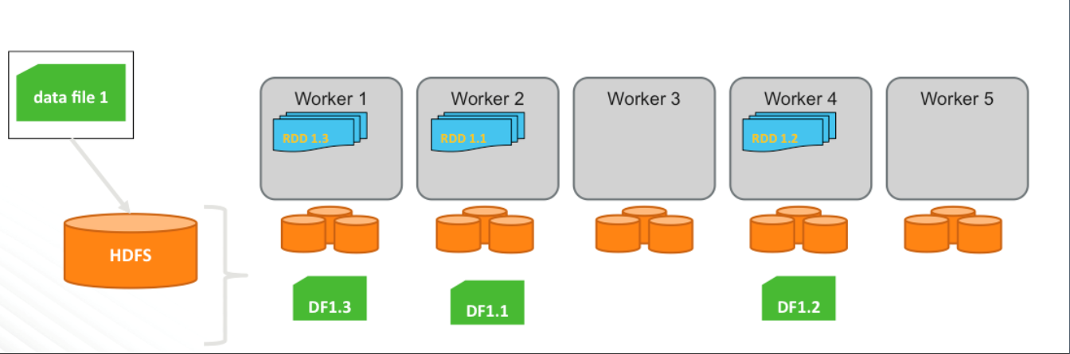
The following series of diagrams is an example of what would be going on with the RDD partitions of data
sc.textFile("statePopulations.csv")
The number of partitions defaults to the number of blocks the file takes up on the HDFS.
Here, if the file takes up three blocks on the HDFS it is represented by a three-partition RDD spread across three worker nodes

Slide 108
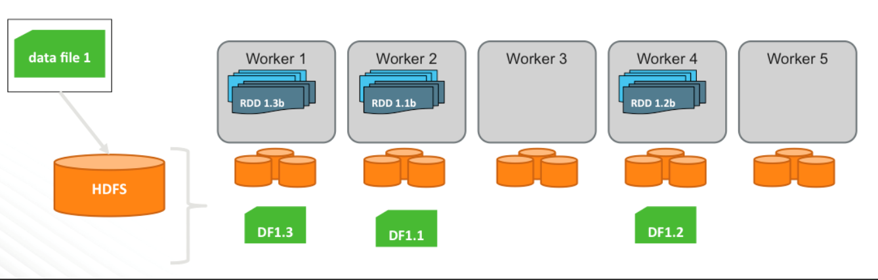
In the first map operation that is splitting the CSV record into attributes, no data needed to be referenced from another partition to perform the map transformation.
.map(lambda line: line.split(",")) \
The same is true for the next map that is creating a PairRDD for each row’s particular state and population count.

Slide 109
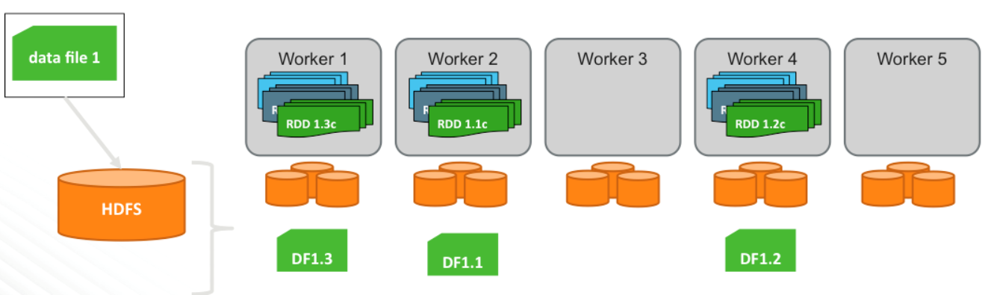
.map(lambda rec: (rec[4],int(rec[5])))
The same is true for the next map that is creating a PairRDD for each row’s particular state and population count.

Slide 110
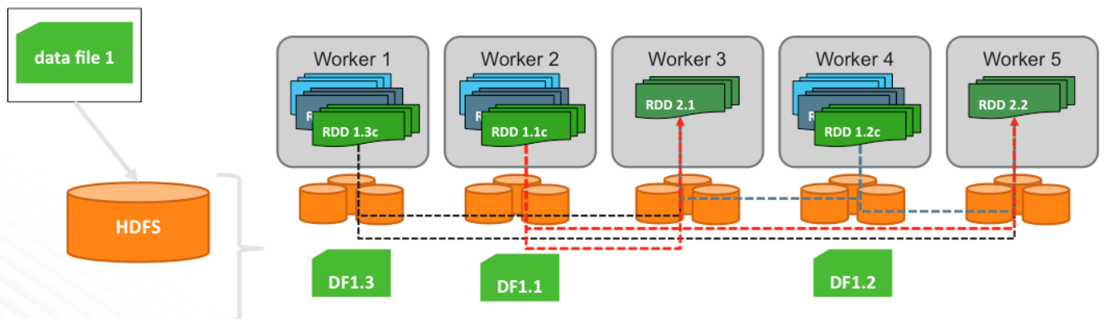
In the reduceByKey transformation that calculates final population totals for each state, there is an explicit reduction in the number of partitions.
.reduceByKey(lambda c1,c2 : c1+c2, numPartitions=2)
The reduction of partitions is controlled by an optional numPartitions argument that reduceByKey() takes.

Slide 111
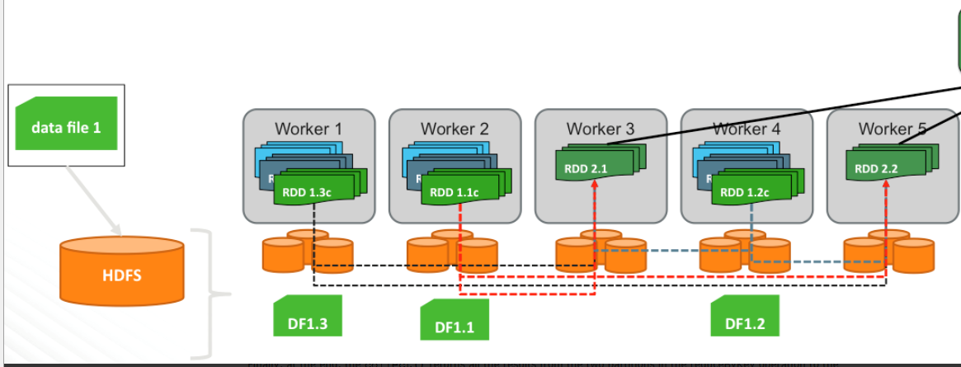
Note also, when doing a reduceByKey(), the same key may be present in multiple partitions that are output from the map operation. When this happens, the data is required to shuffle.
Finally, at the end, the collect() returns all the results from the two partitions in the reduceByKey operation to the driver.

Slide 112
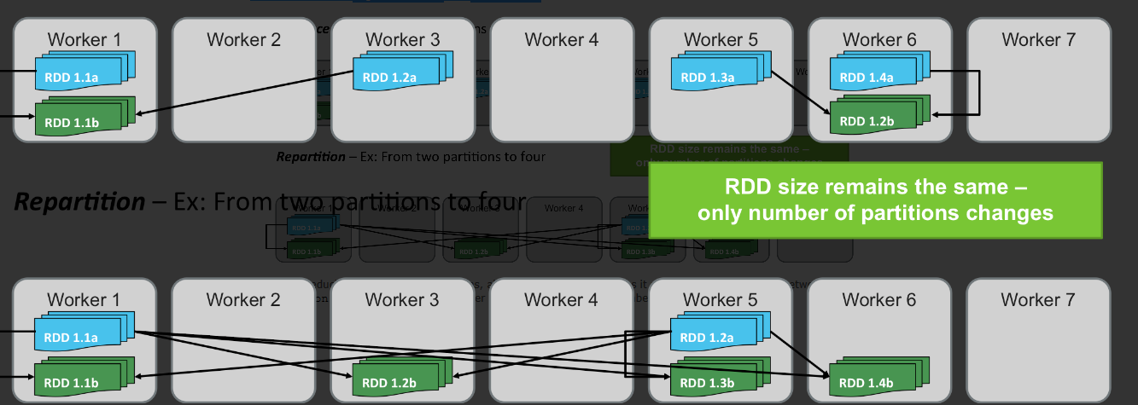
Changing Parallelism without a Transformation :-
Changing the level of parallelism is a very common performance optimization task.
These diagrams illustrates the difference between repartition() and coalesce()

Slide 113
Whenever reducing the number of partitions, always use coalesce(), as it minimizes the amount of network shuffle.
A repartition() is required if the developer is going to increase the number of partitions.

Slide 114
rdd1 = sc.parallelize(range(3),1).map(lambda x:(x,'X')) rdd1.getNumPartitions() 1 rdd1.collect() [(0, 'X'), (1, 'X'), (2, 'X')] rdd2 = sc.parallelize((1,2,3),1).map(lambda y:(y,'Y')) rdd2.getNumPartitions() 1 rdd2.collect() [(1, 'Y'), (2, 'Y'), (3, 'Y')] rdd3 = rdd1.union(rdd2) rdd3.getNumPartitions() 2 rdd3.collect() [(0, 'X'), (1, 'X'), (2, 'X'), (1, 'Y'), (2, 'Y'), (3, 'Y')] rdd3.glom().collect() [[(0, 'X'), (1, 'X'), (2, 'X')], [(1, 'Y'), (2, 'Y'), (3, 'Y')]] rdd3.glom().collect() # make an array for each partition [[(0, 'X'), (1, 'X'), (2, 'X')], [(1, 'Y'), (2, 'Y'), (3, 'Y')]] rdd4 = rdd3.partitionBy(2) rdd4.glom().collect() # this one shows all of same key in same part [[(0, 'X'), (2, 'X'), (2, 'Y')], [(1, 'X'), (1, 'Y'), (3, 'Y')]]

Slide 115
PairRDD Parallelism – Hashed Partitions :-
PairRDDs can be partitioned in such a way that their keys are leveraged when determining how to partition data.
This means that a PairRDD could be created so that all pairs for a given key wind up in the same partition.
When this is done, the resulting partitions are referred to as a "hashed" partitions.
Simply reading an HDFS file or calling parallelize() on a non-RDD dataset does not guarantee that partitions will be hashed partitions.
The same is true for map() operation that creates a PairRDD.
On the other hand, operations such as partitionBy(), cogroup(), join(), reduceByKey() and sortByKey() create hashed partitions by default.
The HashPartitioner component (which must be explicitly imported and called when coding in Scala) guarantees identical keys go to the same partition

Slide 116
This concept allows many operations to skip shuffle steps knowing all the keys are in a single location, thus increasing the performance.
When partitioning data manually, by specifying number of partitions, make sure to be aware of how many executors are being used, and try to have at least one partition per executor.
This can result in performance improvements, particularly when implementing joins.

Slide 117
Preserving Hashed Partitions :-
Once data is using hashed partitioning, keeping this partitioning is important to help downstream operations run faster.
Examples of operations that preserve partitioning are mapValues(), flatMapValues(), filter(), reduceByKey(), groupByKey(), and join().
These operations don't modify keys in hashed partitions.
Spark assumes the data is properly partitioned and uses this assumption to speed up downstream operations.
For example, when using reduceByKey(), all the values for each key are aggregated.
If the data is properly partitioned beforehand, Spark can assume that all the instances of a single key are in the same partition, on the same machine.
With this knowledge, Spark can avoid doing a dataset wide shuffle, and instead all the aggregations can be performed locally.
Continuing the same hash partitioning demo from the previous section, the following example shows that the two partitions from rdd4 are still observed after performing a filter operation.

Slide 118
rdd4.glom().collect() [[(0, 'X'), (2, 'X'), (2, 'Y')], [(1, 'X'), (1, 'Y'), (3, 'Y')]] rdd4.filter(lambda kvp: kvp[0]>=2).glom().collect() [[(2, 'X'), (2, 'Y')], [(3, 'Y')]]

